Slide 1
STUDENT ATTENDANCE MONITORING USING FACIAL RECOGNITION IN A CLASSROOM
Team members
K CHANDRASEKARAN RA1711004040028
S AATHITH RA1711004040030

Slide 2
Existing problem
Student’s attendance in the classroom is a very important task
The existing method of taking attendance consumes a finite of amount of time which can be used for other productive action.
We are focused on addressing this problem on schools and universities only.

Slide 3
Motivation
We found this problem in many universities
We want a reliable system which identifies which student is present in the classroom and gives the attendance based on his presence
This system must not be complex and very easy to interact with it

Slide 4
Existing Recognition systems
The systems can be broadly classified :
Systems that uses human characteristics like fingerprint
Systems that uses unique objects that the person carries like ID card

Slide 5
Fingerprint based recognition system
Distracts the attention of students during lecture time
Queuing takes place

Slide 6
RFID based recognition
Possibilities that Fraudulent may occur
Cheat the system by giving proxy (for example a student misuse it by wearing another student’s ID card )

Slide 7
IRIS based recognition system
Cant use a regular camera
Visible light must be minimized for maximum accuracy

Slide 8
Proposed work
Attendance is monitored and marked present or absent depending upon the presence of the student inside the class at the particular time of lecture
Our solution uses a camera that takes photo of a group of students, and then uses facial recognition for marking attendance for a student
We found that facial recognition overcomes some of the problems that exist in the previously mentioned attendance systems
Our solution makes sure that there is a minimal interaction between students and the attendance monitoring system

Slide 9
Facial recognition
Any facial recognition has 2 steps
Facial detection – the process of finding a face in a given image
Facial recognition – the process of identifying the person from the image of a face (example : face id in apple )
The process of facial recognition occurs in a separate computer as the burden on the camera system must be reduced

Slide 10
Hardware
Camera is installed on the classroom
The role of the camera is just to take pictures
But the process of facial recognition takes place in another computer

Slide 11
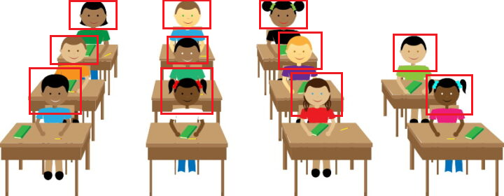
Facial recognition in class – an idea

Slide 12
Sub Systems

Slide 13
Major Sub systems
System Attached in the class to take photos (Image processing)
System that marks the attendance against the face in the photos(ML/DL)

Slide 14
System that takes photo
Contains the following systems inside it
Camera
System that signals the camera
System that transports the photo to next system for processing the photos

Slide 15
System that marks the attendance
Contains the following systems inside it
System that receives the photo
System that runs the face detection algorithm that outputs “m” detected faces
System that outputs a descriptor for “m” faces
System that iterates through “m” descriptor and marks the attendance

Slide 16
More explanation about a few systems that is inside the sub systems

Slide 17
System that marks the attendance - System that outputs a descriptor for “m” faces
System that iterates through the “m” detected faces and calls the following sub systems
System that outputs a descriptor(fixed size) for one face (Facial recognition)
System that stores these “m” descriptors

Slide 18
System that marks the attendance – System that iterates through “m” descriptors and marks the attendance
System that iterates through the database containing “n” descriptors
System that checks whether 2 descriptors are same
System that gives the register number of a given descriptor
System that marks the attendance against the register number

Slide 19
Mathematical Modelling

Slide 20
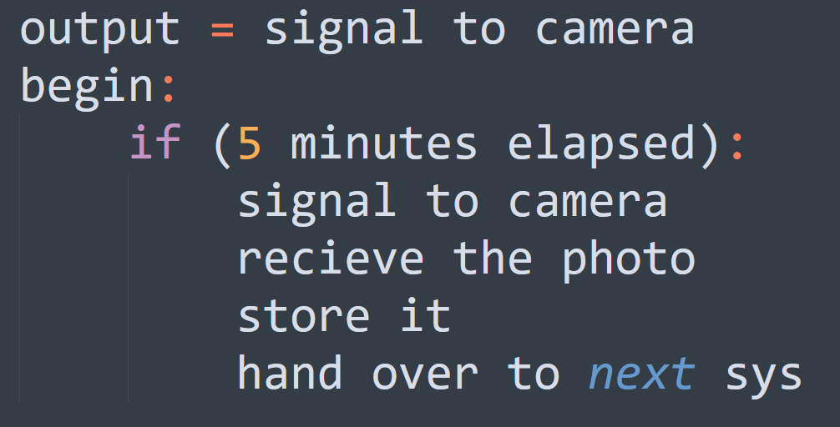
System that takes photo - System that signals the camera

Slide 21
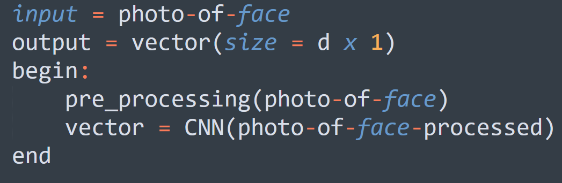
System that marks the attendance - System that outputs a descriptor(fixed size) for one face (Facial recognition)

Slide 22
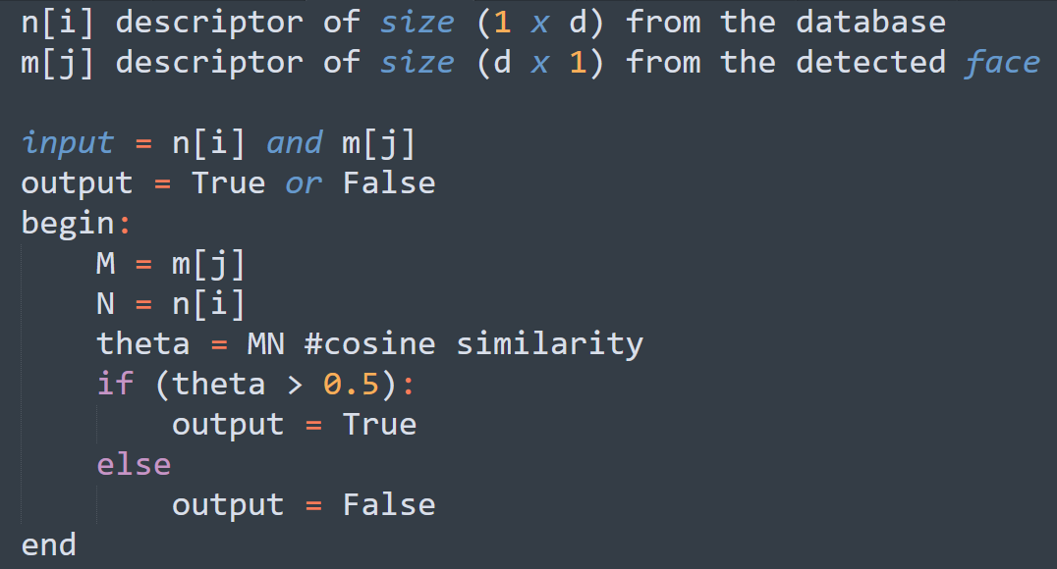
System that marks the attendance - System that checks whether 2 descriptors are same

Slide 23
Objectives

Slide 24
1^{ST Objective}
One camera
One person to stand before the camera
Detect the face in the image and run the face recognition

Slide 25
2nd Objective
One person
A group of people
Run a face detection model to find the faces in the picture and face recognition algorithm against it

Slide 26
3rd Objective
Try different face detection algorithms
Select the algorithm which has lowest false negatives
Note down other metrics like
The least dimension of the facial image that is required for the face detection algorithm

Slide 27
4th Objective
Design the camera position , the angle etc.
The algorithm that was decided on 3rd objective to be used here to test the camera angle and other metrics like finding how many persons can be covered

Slide 28
5th objective
Find the best camera angle and algorithm (both face detection and face recognition) that has reduced false negatives, is fast etc
Iterate through 3 and 4 objective to find the best combination of camera and algorithm

Slide 29
Constraints

Slide 30
Camera
Proper lighting should be there
The position of camera should not be changed as it is fixed (depends on the algorithm )
As when the distance increases we will reduce the image resolution of detected face

Slide 31
Face detection and recognition
The face or faces should not be covered
There is a maximum distance till which a student can sit for the camera to detect the face beyond that facial recognition wont work
When the photo is taken if he/she covers their face then the algorithm can miss the attendance of the person in that time frame
If physical characteristics of people change over time — if they gain weight, lose their hair, grow a beard or start wearing glasses, it is tough for face recognition

Slide 32
Conceptual Design

Slide 33
3 questions
What are the needs
A reliable system which identifies which student is present in the classroom and gives the attendance based on his presence
How can the needs be met
uses a camera that takes photo of a group of students, and then uses facial recognition for marking attendance for a student
How well the needs are met
found that facial recognition overcomes some of the problems that exist in the previously mentioned bio metric attendance systems subjected to the constraints mentioned in the previous slides

Slide 34
A basic block diagram

Slide 35
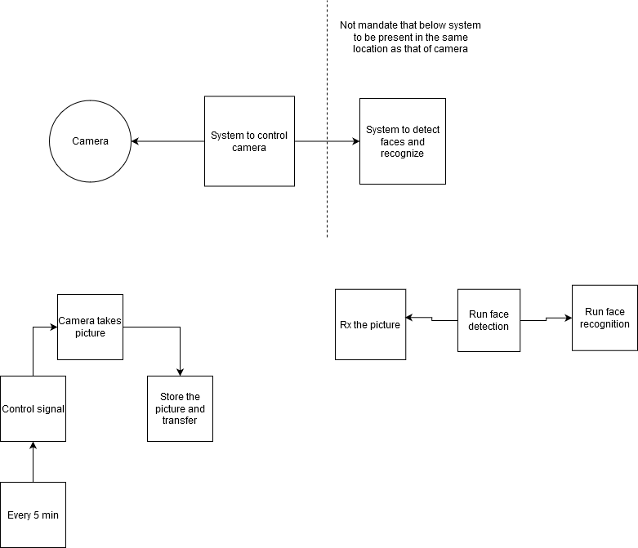

Slide 36
Thank You

